Slide 2
HOUSEKEEPING
Go home if you’re sick!
Phones and pagers
Bathrooms and security
Confidentiality
PPE
Notes:
Standard course introduction with 2 main differences:
Ensure no-one who is sick is on the course
Explain PPE use during course
Ideally should be brought by participants and reused by same participant between scenarios

Slide 3
LEARNING OBJECTIVES
Infection control for airway management
Variations to routine RSI
Resource and equipment considerations
Simulation-based practice of RSI with use of cognitive aids
Developing a plan for how this will look at your place of work
Notes:
Introduction of learning objectives
Emphasise that course is not intended to provide proscriptive advice for every department/hospital, but (as much as possible) to educate participants on general principles as outlined in consensus guidelines (Safe Airway Society, CEC, WHO)
Primary aim is to have participants actively thinking about how they would implement these principles at their place of work
Throughout slides, questions in BLUE are directed to participants to stimulate discussion around this

Slide 4
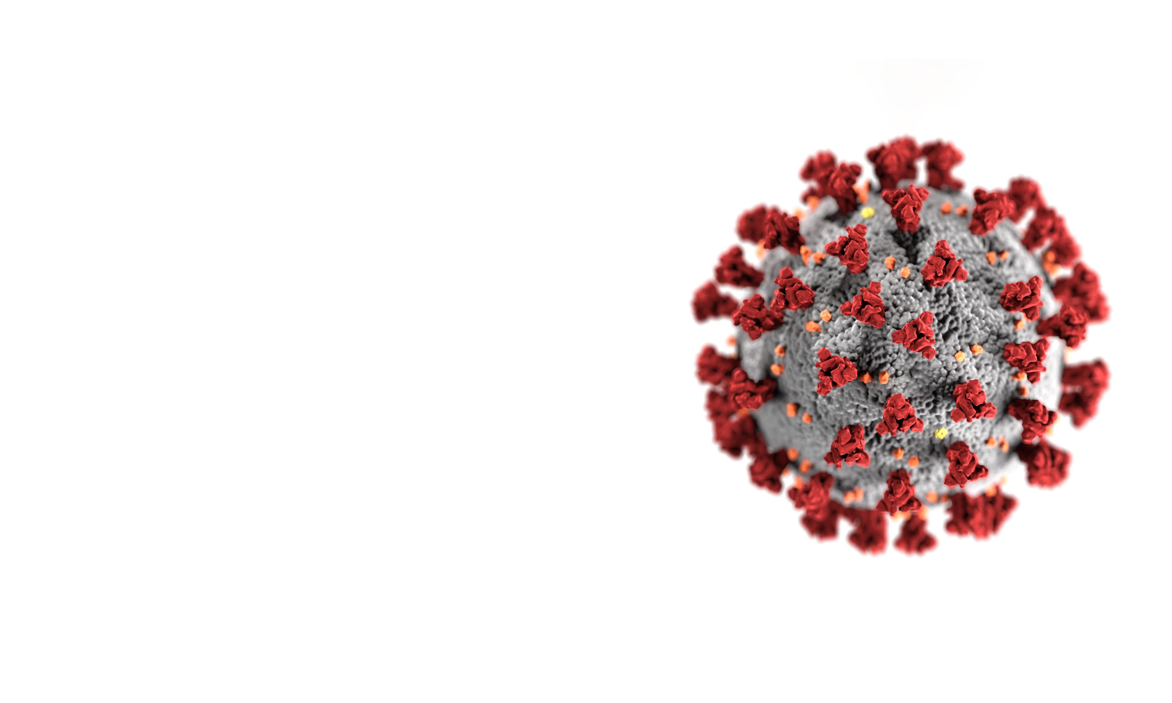
ENVIRONMENT & EQUIPMENT

Slide 5
GENERAL PRINCIPLES
Use dedicated spaces for intubation/extubation
Use disposable (NOT reusable) items where possible
Avoid contamination of general equipment
Notes:
Introduce general principles
Not stated on slide, but an issue that may come up, is that departments should use what they have and are familiar with and not necessarily rely on new equipment (that may not arrive, require training to use etc…)

Slide 6
LOCATION
Use a designated area
Ideally, a negative pressure room with ante-room
If unavailable, normal pressure room with closed doors
Where is this in your department?
What if you run out of spaces?
Notes:
General principle: a designated area (such as specific rooms/theatres)
Important to acknowledge that ideal location may not be available in a lot of departments
Prompt participants to think about where this would be in their department/hospital
Forward planning – enquire whether participants have thought about what they would do when presentations increase, and whether they have a fallback option
Potentially moving intubated patients out and reusing room for intubation
What are the barriers to this? (cleaning, cohorting intubated patients)
Wards designated for intubation
Location of donning and doffing areas, PPE requirements for staff?

Slide 7
EQUIPMENT
Decide what you want to take inside the room (and will get contaminated)
If disposable, is there enough stock?
Do items need to be sterilised?
Pre-prepared packs or checklists?
What needs to be immediately available outside the room?
Notes:
General principle – use available equipment to make first attempt the best attempt, but avoid contaminating scarce resources and resource intensive cleaning processes.
Prompt participants to think about disposables, stock and sterilisations
General principle – avoid situations where staff need to constantly go in and out of the room to obtain equipment
Discussion around how to avoid this (equipment checklists, prepared packs)
Discussion around what they definitely need in the room vs. what they might need and can stay outside
This would also be an opportunity to discuss whether front of neck access and CPR should be performed (if those items are going to be available outside the room)
The default position for most ED physicians would be to do both if the patient was appropriate for intubation
However, it is important to make sure that the entire team is aware of this to avoid disasters inside the room

Slide 8
VARIATIONS TO ROUTINE PRACTICE

Slide 9
General principles
Minimise aerosolization of virus
Minimise number of staff exposed
Minimise time staff are exposed
Notes:
Introduce general principles
As much as possible, relate recommendations in following slides to one or more of these principles
Variations to practice are ok as long as they do not violate one of these principles

Slide 10
INTUBATION TEAM
Airway operator – most experienced clinician
The anaesthetic consultant should not be there for ‘backup’
Airway assistant – experienced nurse/doctor
Second senior airway clinician – team lead, administer drugs, surgical airway if required
Runners (up to 3) – inside room (optional), in anteroom/at door, outside room
Who will fill these roles?
What happens after hours?
Notes:
Explain team roles
Emphasise that team should be senior/experienced in order to ensure intubation is quick
No unnecessary staff in room – each should have a role
There may be resistance to the idea of having a second clinician in the room – this can be further discussed in the simulation scenarios
A requirement for the airway operator is a correctly fitting P2/N95 mask – if an adequate seal is unable to be obtained, then another intubator will be required
There may be discussion around whether a surgical airway should be performed in these patients (risk of aerosolization)
Prompt discussion as to whether a team of this size is feasible for participants, and how composition would change outside of business hours when senior staff are less available

Slide 11
PRE-OXYGENATION
Minimum flow of O₂ to maintain saturations prior to team entering room
Once team enters, pre-oxygenate with either BVM or Mapleson circuit (with viral filter and ETCO₂ already connected)
Avoid manual ventilation as much as possible and ensure leaks are minimised
NO apnoeic oxygenation
Notes:
General principle for recommendations – minimise aerosolization
Clarify that pre-oxygenation does not start until team enters room
Explain pre-assembled circuit setup (viral filter, ETCO2) – may require practical demonstration
PEEP valves if available
There may discussion around pre-oxygenating the agitated patient – delayed sequence intubation is ok to use

Slide 12
INDUCTION
Rocuronium (>1.5mg/kg IBW) or suxamethonium (1.5mg/kg)
Be generous to minimise risk of coughing during instrumentation
Ensure ≥ 60 seconds post administration to prevent coughing
Manual ventilation probably better than intubation with inadequate paralysis in the event of desaturation
Notes:
General principle – minimise aerosolization by avoiding coughing
There may be discussion around specific muscle relaxants:
Rocuronium good due to duration of effect but suxamethonium quicker (patients WILL desaturate) and fasciculations allow confidence that patient will not cough
Suxamethonium followed by rocuronium a perfectly reasonable option
Emphasis on providing adequate time for relaxants to work
Desaturations likely – discussion around precipitously intubating vs waiting and manually ventilating patient

Slide 13
INTUBATION
1st attempt should be the best attempt
Video laryngoscope if available – stand upright and use screen (indirect view)
Depth correct on 1st attempt – minimise disconnections and cuff deflations
Cuff up before ventilating
Avoid contamination by used bougie/stylet/mask/laryngoscope – place on bluey for disposal
Notes:
General principle – minimise aerosolization and time by getting ETT in the right place as quickly as possible
Discussion around video laryngoscopes available and technique for use
Likely to tolerate less than perfect tube positions in these patients
For anaesthetic nurses – no listening for a leak as inflating cuff as per usual practice
Some groups might choose to use a bin next to the bed or a large plastic sheet for contaminated equipment

Slide 14
POST INTUBATION
Careful disposal of contaminated equipment
Clinical waste bins available and emptied?
Sterilisation process and turnaround?
PPE removal
How to ensure this is done correctly?
Notes:
Prompt discussion (if it has not already occurred) on how waste will be managed
Emphasis on PPE removal as critical step
Participants to consider how they would ensure this occurs correctly (buddy system, posters on how to doff correctly etc…)
There may be discussion around transport/transfer

Slide 15
SCENARIO
Notes:
Explain to participants that you will briefly outline a situation they might find themselves in and ask them what they would do
Audio file should play automatically on clicking to the next slide

Slide 16
You hear this sound coming from the room next door. What do you do?
Go in and check on the patient
Stop anyone from going in until they’ve put on PPE
Notes:
Audio file should play automatically
Explain situation and ask participants:
What they would do
What they would want to do
Can allow audio to continue playing until it finishes (1:08 duration) or click to next slide to stop

Slide 17
BEING ‘OK’
Patient safety is NOT first priority
Avoiding healthcare worker infection takes precedence
This WILL cause distress
How do you look after your staff?
Notes:
Following on from previous slide:
Ask for reactions to previous slide and why people felt that way
Emphasise need to keep healthcare workers safe
Maintain workforce
Avoid infection of colleagues
Avoid infection of families of healthcare workers
Acknowledge that distress/moral injury/unwellbeing is inevitable
Could get worse if resources depleted
Some discussion around strategies to cope
Debriefing individually/groups?
Training (to an extent)?
Another significant learning point from this slide is that ED monitors will not routinely have tone modulation, and tone modulation is different between different monitors – cannot reliably tell SpO2 from tone

Slide 18
SIMULATION SCENARIOS
Notes:
Breakup into groups and introduction to sim scenarios

